Slide 1

"SILKWORM INCUBATOR"
Track 2- PAPER ID- 137
PRESENTER- ILLURU SAI JAHNAVI
Department of Computer Science and Engineering, Kalasalingam Academy of Research and Education, Virudhunagar, India
Email-jahnavi1096@gmail.com

Slide 2
Agenda
Purpose
Objective
Literature Survey
Tools Required
Proposed Work
Methodology
Circuit Diagram
Working
Results
References

Slide 3
Purpose
The main purpose of Sericulture is production of silk by rearing of silkworms. Silkworms survive on the environmental conditions like Relative Humidity, Temperature, air circulation, light duration and gases. The lifespan of silkworm is around 6-8 weeks (from hatching to cocoons and pupae). Sericulture involves in rearing of silkworms to produce raw silk from cocoons. Silk is produced by spinning and reeling the cocoons which helps in processing and weaving The major activities of sericulture comprise of food-plant cultivation to feed the silkworms which spin silk cocoons and reeling the cocoons for unwinding the silk filament for value-added benefits such as processing and weaving.
Environmental conditions plays a major role for silkworm growth.
Temperature
Humidity
Air & Light

Slide 4
Objective
Helping the farmers by preparing automatic cost effective silk worm incubator.
Community: Agriculture
To increase the production of silk

Slide 5
Literature Survey:
Title of the Research | Author | Year | Methodology
Management of Climatic Factors for Successful Silkworm (Bombyx mori L.) Crop and Higher Silk Production | V. K. Rahmathulla | 2012 | This paper discuss about the climatic factors which effect the productions of silk worm production growth.
Carbohydrate metabolism and restricted oxygen supply in the eggs of the silkworm, Bombyx mori | Sonobe, H., Matsumoto, A., Fukuzaki, Y., & Fujiwara, S | 1979 | This paper tells about the oxygen supply required for eggs in the silk worm.
Cultivation of the virus of grasserie in silkworm tissue cultures | Trager, William | 1935 | This paper tells about the growing of female silkworm effects some of the health issues.

Slide 6
Literature Survey:
Title of the Research | Author | Year | Methodology
The scientific basis of the implementation of differential incubation periods of mulberry silkworm seeds in the harsh continental climate of Central Asia | Jumaghulov, K. A., & Rakhmanova, K. E. | 2023 | This paper tells about how mulberry leaves feddes in the stages of silkworms.
Biotechnological Importance of Cocoon Magnetization with Particular Reference to the Larval Performance of Multivoltine Mulberry Silkworm | Prasad, S., and V. B. Upadhyay. | 2011 | This paper tells about how the cocoon magnetization effect the larval performance.
Internet of Things Based Innovative and Cost-effective Smart Sericulture Farm Incubator | Mekala, V., Tamilsehan, K. S., Vinod, V. M. | 2021 | This paper discuss about how to implement the silkworm incubator based on internet of things based sensors.

Slide 7
Tools Required
Hardware Requirements
TEMPERATURE AND HUMIDITY SENSOR
RELAY
NODEMCU (ESP8266)
LED
COOLING FAN
JUMPER WIRES
3.7V BATTERY
Software Requirements
Arduino IDE

Slide 8
Proposed Work
The framework proposed is implemented with the help of both software and hardware tools, that will control the variations of environmental factors in silkworm incubator for healthy growth of silkworm.
The proposed system does the following things:
Temperature range of silkworm incubator is 23-28*C,
Ideal humidity range is 70-80% with the help of hardware and software requirements.
NodeMCU works as microcontroller. Temperature and Humidity sensor (DHT22) takes temperature and humidity, and gives to Nodemcu to measure temperature and humidity. Relay, cooling fan, 3.7v battery, LED, dht22 connects with nodemcu directly or indirectly with the help jumper wires. The hardware components connect with Nodemcu and Arduino IDE is a software requirement where we used to code with Nodemcu and other hardware components. The Nodemcu and PC connect each other with the help of connector (usb cable). If the temperature is high then light will be turned off, cooling will be turned on and if the temperature is low then light will be turned on, cooling fan will be turned off. The process will be done automatically. The proposed system is shown in the following figure1.

Slide 9
Methodology
The Silkworm Incubator system consists of Temperature and Humidity Sensor (DHT22), Relay, 3.7V Battery, NodeMCU, LED, Cooling Fan, USB Connector, Cloud. NodeMCU is programmed and has the ability to monitor and control the model.
The framework consists of both the software and hardware.
The NodeMCU will be connected with PC via connecter (USB Cable). The whole setup will be directly or indirectly linked with NodeMCU.
The main purpose of the program design is to mechanize the action of the controller.
Printed circuit board is loaded with the code via selected ports to achieve the required task. Here we have used COM4 port.
It is easiest way to control the whole procedure based on the circumstances given in the code.
The program is written in Arduino integrated development environment (IDE) in similar way to maintain the needed environmental conditions. This code will helps in automation of Silkworm Incubator.

Slide 10
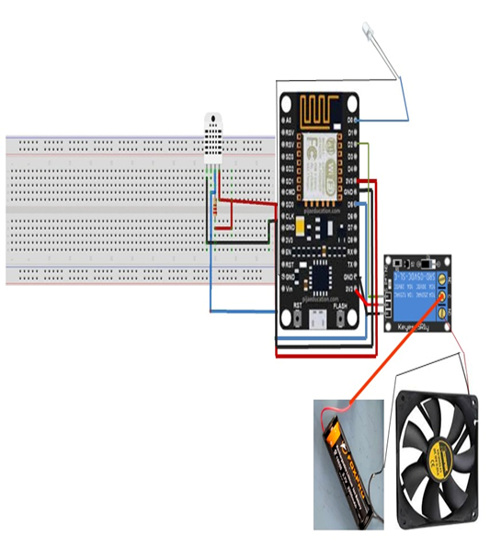
Circuit Diagram

Slide 11
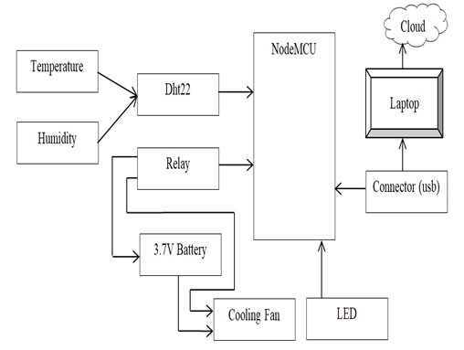
Working

Slide 12
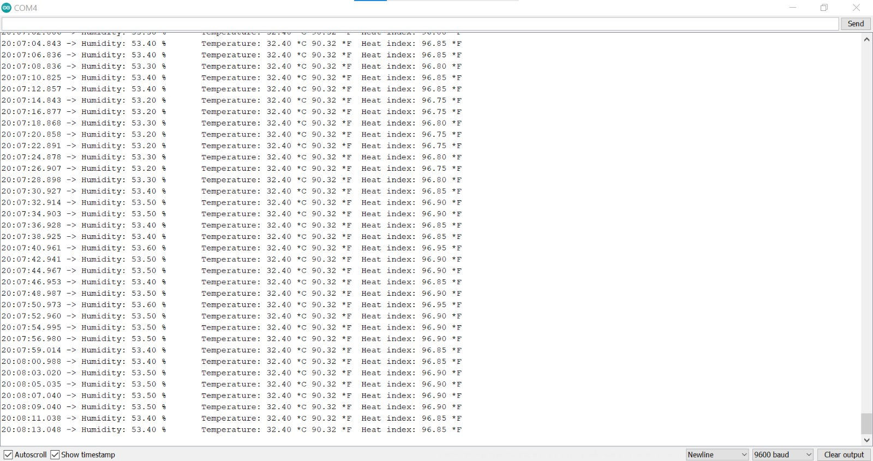
Results
It reads temperature and humidity data from dht22 and then checks the temperature and humidity readings. if they are valid then prints the readings to serial monitor as shown below

Slide 13
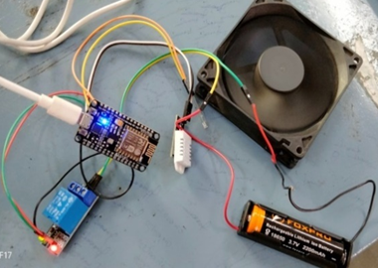
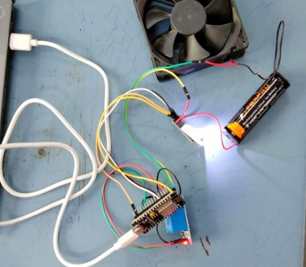
If the temperature is higher than 28*C, it turns on the fan and turns off an LED as shown below
If the temperature is less than or equal to 28*C, it turns off the fan and turns on an LED as shown below

Slide 14
Conclusion
From this project we can conclude variations occurred in automation of the silkworm incubator prototype.
It uses dht22 sensor to monitor the environmental conditions and controls the temperature and humidity based on the readings.
When temperature is high cooling fan turns on and LED turns off, when temperature is low cooling fan turns off and LED turns on.
Overall, the prototype shows how nodemcu and other components are used to create a system that can provide the optimal environment conditions for silkworm growth. In future work we grow the silkworms with our equipment and the data will be stored in cloud these data will be used for analysis.

Slide 15
References
Rahmathulla, V. K. "Management of climatic factors for successful silkworm (Bombyx mori L.) crop and higher silk production: a review." Psyche: A Journal of Entomology 2012 (2012).
Sonobe, H., et al. "Carbohydrate metabolism and restricted oxygen supply in the eggs of the silkworm, Bombyx mori." Journal of Insect Physiology 25.5 (1979): 381-388.
Trager, William. "Cultivation of the virus of grasserie in silkworm tissue cultures." The Journal of Experimental Medicine 61.4 (1935): 501.
Mekala, V., et al. "Internet of Things Based Innovative and Cost-effective Smart Sericulture Farm Incubator." 2021 5th International Conference on Electronics, Communication and Aerospace Technology (ICECA). IEEE, 2021.
Jumaghulov, Kh A., and Kh E. Rakhmanova. "The scientific basis of the implementation of differential incubation periods of mulberry silkworm (Bombyx mori L.) seeds in the harsh continental climate of Central Asia." IOP Conference Series: Earth and Environmental Science. Vol. 1142. No. 1. IOP Publishing, 2023.
Prasad, S., and V. B. Upadhyay. "Biotechnological importance of cocoon magnetization with particular reference to the larval performance of multivoltine mulberry silkworm (Bombyx mori Linn.)." Middle-East J. Sci. Res 10.5 (2011): 565-572.

Slide 16
Yamashita, Okitsugu, and Toshinobu Yaginuma. "Silkworm eggs at low temperatures: implications for sericulture." Insects at low temperature (1991): 424-445.
Saha, A. K., et al. "Low cost incubation pot for better hatching of silkworm eggs in dry summer." UTTAR PRADESH JOURNAL OF ZOOLOGY (2002): 263-267.
He, Weiyi, et al. "Effect of heat, enzymatic hydrolysis and acid-alkali treatment on the allergenicity of silkworm pupa protein extract." Food chemistry 343 (2021): 128461.
Altomare, Alessandra Anna, et al. "Silkworm pupae as source of high‐value edible proteins and of bioactive peptides." Food Science & Nutrition 8.6 (2020): 2652-2661.
Yashaswini, B., Nagmani Madhusudhan, and D. Suresh. "Automated smart sericulture based on IoT and image processing technique 10 (6)." ISSN 2321.3361 (2020): 2020.
Nikitha, Mrs. "Efficient water management system for mulberry garden using IOT."
Rasooli, Mohammad Wasi, Brij Bhushan, and Nagesh Kumar. "Applicability of wireless sensor networks & IoT in saffron & wheat crops: A smart agriculture perspective." Int. J. Sci. Technol. Res 9.2 (2020): 2456-2461.
Jegadeesan, S., et al. "ISISF: IoT Based Smart Incubator for Sericulture Farm." International Journal of Modern Agriculture 10.2 (2021): 3202-3208.
Sreedhar, Guru, Lakhan B. Makam, and Mr Mylara Reddy. "Intelligent Control System for Sericulture using IoT." Journal of Xi'an University of Architecture & Technology 12.4 (2020): 3967.

Slide 17


